Slide 1
A data quality assessment workflow for additive manufacturing
Ayyoub Aggour, Shengyen Li

Slide 2
Agenda
Background
Problem
Goal
Approach
Statistical Analyses
Feature Selection
Machine Learning
Results

Slide 3
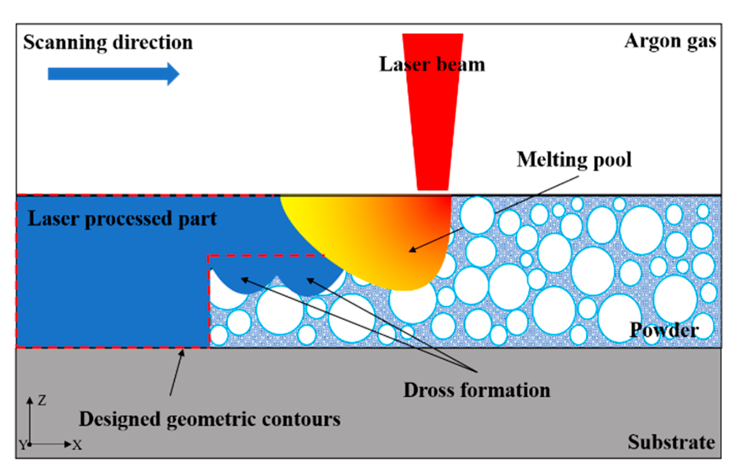
Background
Additive Manufacturing
Speed and Efficiency
Reduced Waste
Innovation
Applications: Aerospace Industry, Automotive Industry, Medical and Dental, Jewelry and Art, R & D
Notes:
Additive manufacturing is becoming increasingly popular and important in our society for a variety of reasons. The pros of using Additive manufacturing is that it prioritizes →
Speed and Efficiency: Reduces the need for large inventories and allows for faster development
Reduced Waste: Builds layer by layer which minimizes waste compared to subtractive manufacturing which has lots of waste
Innovation: AM allows for rapid prototyping and the creation of new materials and composites
Medical: Custom prosthetics and surgical tools
Aerospace + Automotive: Lightweight parts
Laser Powder Bed Fusion (LPBF) is a common form of Additive manufacturing, specifically for metal parts. It is useful because it allows for intricate designs, lightweight parts, and optimized geometries to be effectively manufactured. LPBF involves using metal powders which are applied by a powder recoater and a laser that melts the powder to create the part. The laser creates a melt pool just like the one shown in the picture. It affects the built in microstructures which can lead to a high residual stress. These factors which impact the parts integrity and structure can be crucial when it comes to creating parts that need to be accurate.

Slide 4
Problem
Main Issues:
Residual Stresses: Rapid heating and cooling during the LPBF process can lead to significant stress on the part, often causing warping or cracking
Building Strategy: For example, Laser power and scanning speed can lead to inconsistencies in bonding and part density
Other Issues:
Build Times: LPBF can be extremely time-consuming and increases production costs
Notes:
The main issue we have is the residual stresses and warping, due to the rapid heating and cooling cycles during LPBF it can cause significant stresses in the material. The melt pools that are caused by the laser are the main cause of this warping and cause deformation, or even cracking in the final part. This can be extremely dangerous as many applications for LPBF include airplane and car parts. If these parts are too inaccurate, it can cause malfunctions within the system.

Slide 5
Goal
Develop a framework to evaluate the quality of the simulations, including data quality and model fidelity
Notes:
We can experiment with this physically by editing the machine's parameters each time to see how it affects the part. However, this can take up to a month to receive results and costs thousands or hundreds of thousands of dollars. The goal we have is to achieve the same accuracy without editing the machine's parameters each time.
Fidelity – Accuracy

Slide 6
Approach
Statistical Analyses
Statistical analyses are used to make inferences or draw conclusions based on a sample of data. They help determine if observed patterns or differences are statistically significant or if they could have occurred by random chance or uncertainty.
Data Cleaning
Data cleaning is the step in the data preparation process, ensuring that data is accurate, consistent, and usable for analysis.
Feature Selection
Feature selection is the process in data analysis and machine learning which aims to identify the most relevant features/variables to use in a model.
Machine Learning
Machine learning (ML) involves training algorithms to learn from and make predictions or decisions based on data.

Slide 7



Tools/Libraries
Jupyter Notebook: Web-based development Environment
ChatGPT: Natural language processing tool
Pandas: Python Library
Scikit: Python Library
Matplotlib: Python Library
Notes:
Jupyter Notebook: Jupyter during my internship served as an IDE even though it is a web-based development environment where I would do all my coding. I think that it is a very good tool to anyone who needs to code and organize their code
ChatGPT: It works by predicting the next word in a text based on patterns it has learned during its training process. ChatGPT then tries to predict what the next word should be based on the examples it was given.
Pros: ChatGPT is extremely good at code debugging and editing code. It is also a great learning tool for learning syntax or trying to understand code.
Cons: There's a few downsides but the main one is that you must be very specific in your prompts.
Pandas: Pandas was one of my most important and most used libraries when doing data manipulation and analysis. I used it for things like data cleaning, handling missing data, and integrating my data with other libraries.
Scikit: My use for Scikit was mainly its wide variety of machine learning algorithms. In addition to its ML algorithms, it also provided me with model evaluation metrics and hyperparameter tuning.
Matplotlib: Matplotlib was used to create graphs and visualize the data. Just like pandas, it was easily compatible with other libraries to generate the graphs I wanted. The most useful part of matplotlib for me is its customization, because I can plot almost everything and add lines where I want.

Slide 8
Statistical Analyses - Terms
Null Hypothesis (H₀): Default hypothesis/Accepted fact
Example: Class A has a higher GPA than Class B
Alternative Hypothesis (H₁): The hypothesis we want to test
Example: Class A does not have a higher GPA than class B
P-value: Describes how likely your data would have occurred by random chance if the null hypothesis were true
The smaller the p-value the more likely you are to reject the null hypothesis

Slide 9
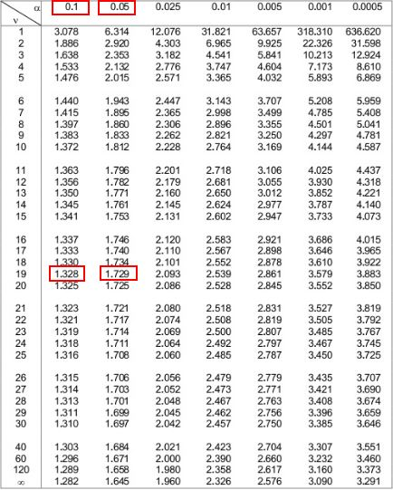
Statistical Analyses – T-test
Three Types of T-tests:
One Sample t-test
Comparing the mean of one group against the mean of a population
Paired Sample t-test
Compares the means of two measurements taken from the same population
Independent Two-Sample test
Analyzes the mean comparison of two independent groups
Notes:
The main idea of a T-test is to compare the means of two groups. It is often used to determine whether a process or treatment influences the population or finding out if two groups differ from each other. I won't go into the math because we could be here for hours but ill explain how to understand the values.
So if your T-value of 0 means it means that the sample result is exactly equal to the null hypothesis.
Degrees of Freedom Formulas: One Sample: number of samples - 1
Two Sample: n1 + n2 - 2
Paired Sample: number of pairs - 1
T-distributions:
These are made when you draw multiple samples of the same size from the same population and perform the same t-test. Your result would be many t-values which you could then plot, often creating a bell curve.
The peak of the graph is at an x value of 0 because t-distributions assume that the null hypothesis is true
T-values become less likely as you go farther left or right on the graph, meaning that when the null hypothesis is true you are less likely to receive a sample that is very different from the null hypothesis
p-value:
To obtain the p-value use a chart that contains all the values
Example: When getting p-value, you shade the parts of the graph that are greater than the t-value and incase of a two tailed test shade above the positive/negative of the t-value. If the shaded region where to be 0.06 or 6% it would not be enough to reject the null hypothesis using the common significance level of 0.05 or 5%

Slide 10
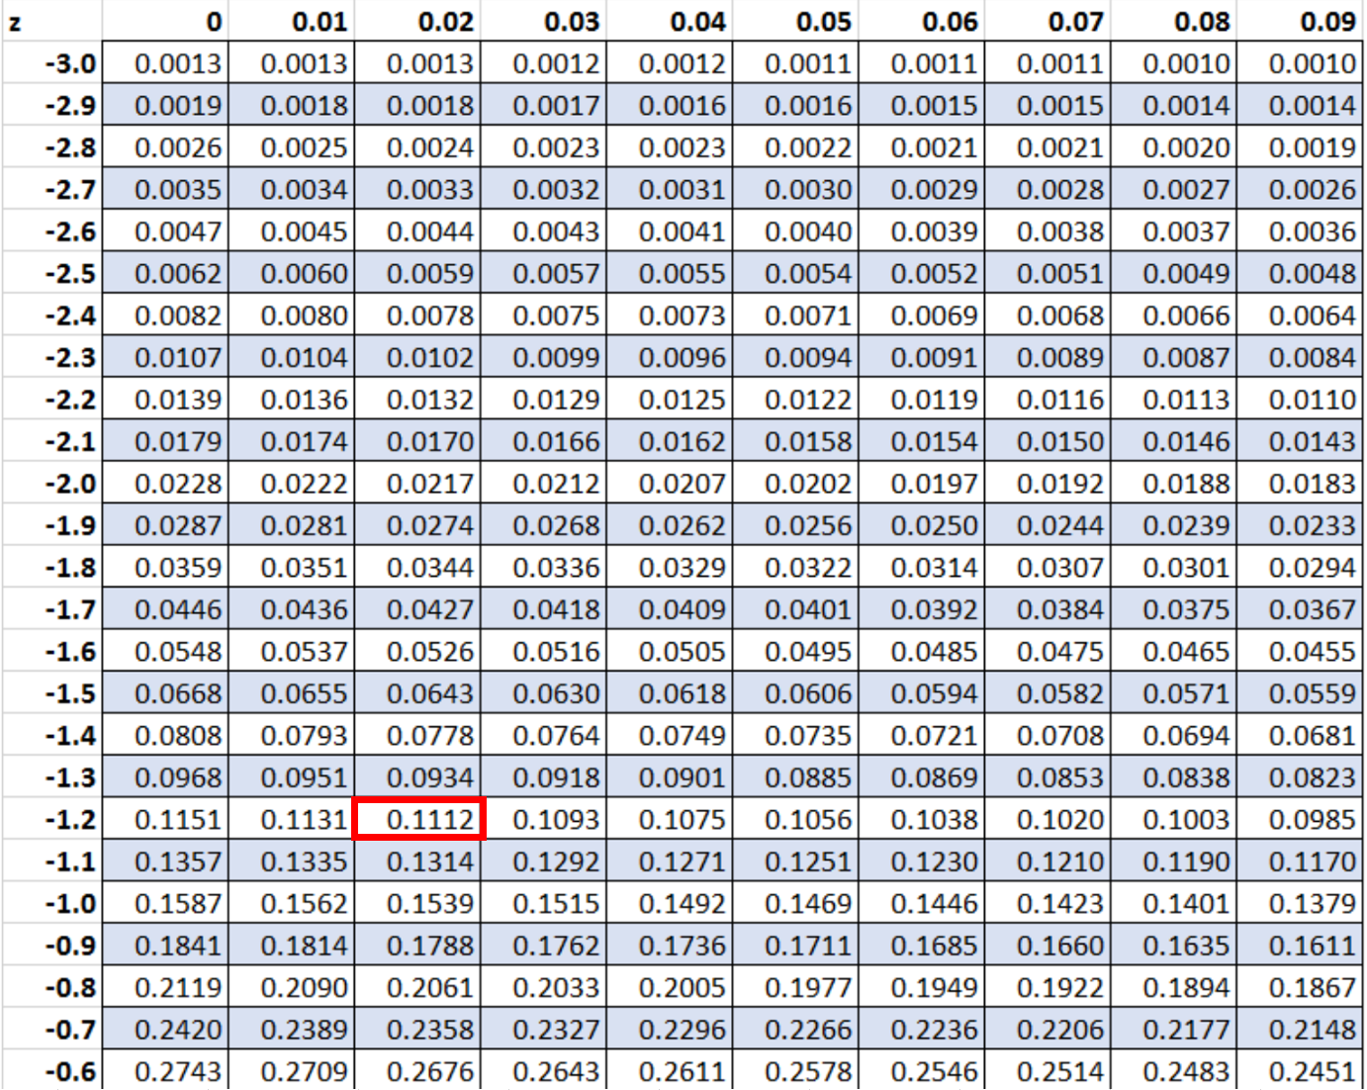
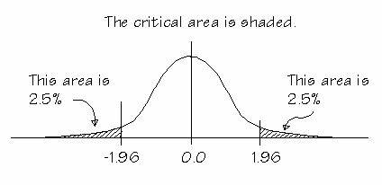
Statistical Analyses – Z-test
Two Types of Z-tests:
One Sample Z-test
Determine whether a population mean is different from a hypothesized value
Two Sample Z-test
Determine whether two population means differ
Critical Values:
If the Z-value is outside of the critical values, then it is considered statistically significant
Notes:
A Z-test is very similar to a T-test in how we are trying to determine the significance of a set of data.
The one major difference between a Z-test and a T-test is that a Z-test is generally used for larger amounts of data, generally sample sizes larger than 30.
To get your P-value, much like a T-test, you use a table that contains a list of the possible Z values and the corresponding P-values.
Something statistically significant is unlikely to be explained by chance or random factors.

Slide 11
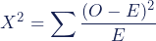
Statistical Analyses – Chi-squared (X^2) test
Two Types of X^2 Tests:
Chi-Square Goodness of Fit Test
Determine whether a categorical variable follows a hypothesized distribution
Chi-Square Test of Independence
Determine whether there is a significant association between two categorical variables
Notes:
For the Goodness of Fit Test to get the critical value, first you take the degrees of freedom and minus one. Then you take the significance level and compare the df and significance level on a table to get the critical value.
To get the Expected Values you do →
Expected Count = Expected percentage * Total count
Example: Customers in the store
Total = 250
20% of customers each day (M-F)
Result: 0.2 * 250 = 50
For the Test of Independence to get the critical value you calculate df using the formula →
df = (number of variable #1 groups − 1) * (number of variable #2 groups − 1)
Then same as the other one you take the significance level and compare the df and significance level on a table to get the critical value
Then, to get the Expected Values you do →
Expected Values Calculation
Expected Count = (row sum * column sum) / table sum
Example: Male Republicans
Males = 250
Republicans = 230
Total = 500
Result: (230 * 250) / 500 = 115
Time: 4-5 mins

Slide 12
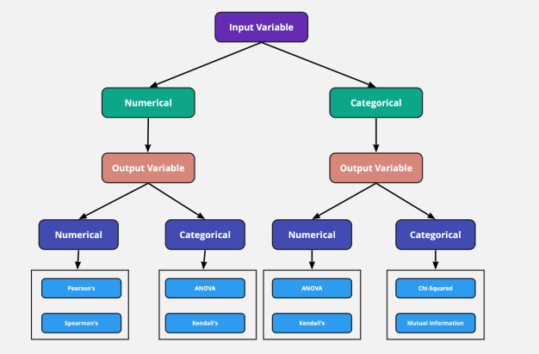
Feature Selection
Importance: Model Performance, Preventing Overfitting, Efficiency
Methods: Filter Methods, Wrapper Methods, Embedded Methods
Challenges: Complexity, Correlation, Overfitting
Notes:
-Importance-
Model Performance and Efficiency: Selecting relevant features can greatly increase the accuracy of and efficiency of the model
Preventing Overfitting: Reduce the risk of overfitting by minimizing the noise introduced by irrelevant features
-Methods-
Filter Methods: Evaluates feature independently of the model by using statistical techniques to select features based on relevance to the target variable
Example: Correlation Coefficient, Chi-Square Test
Wrapper Methods: Evaluates subsets of features by training and assessing a models performance
Example: Forward Selection, Backward Elimination, RFE
Embedded Methods: Perform feature selection as part of the model training process
Example: Decision Trees, Regularization
-Challenges-
Complexity: Datasets much like the one I used contained many features which caused the process to become slightly complex and computationally heavy
Correlation: Features that are *too* highly correlated can actually cause issues and complicate the process
Overfitting: Selecting too many features leads to overfitting which happens when the model memorizes the dataset instead of being able to predict data. This causes the model to perform well on the original dataset but bad on new data.

Slide 13
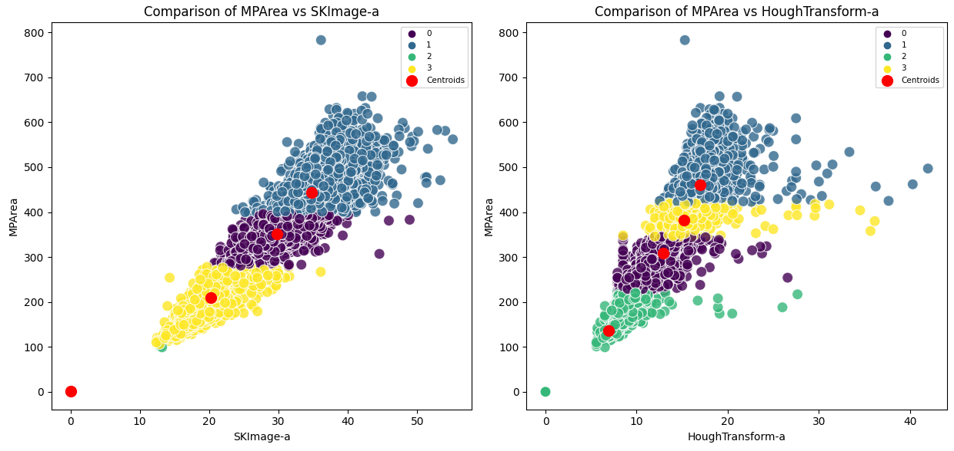
Machine Learning
Supervised Learning
Classification
Regression
Unsupervised Learning
Clustering
PCA
Notes:
-Supervised Learning: The model is trained on labeled data where the outcome is known. The goal of this is for the model to be able to learn the inputs and predict the outcomes.
Classification: Predicting discrete labels, species
Regression: Predicting continuous values, numbers
-Unsupervised Learning: The model is trained on unlabeled data where the outcome is unknown. The goal is for the model to find hidden patterns within the data.
Clustering: Grouping similar data points together
PCA: Reducing the number of features while retaining important information

Slide 14
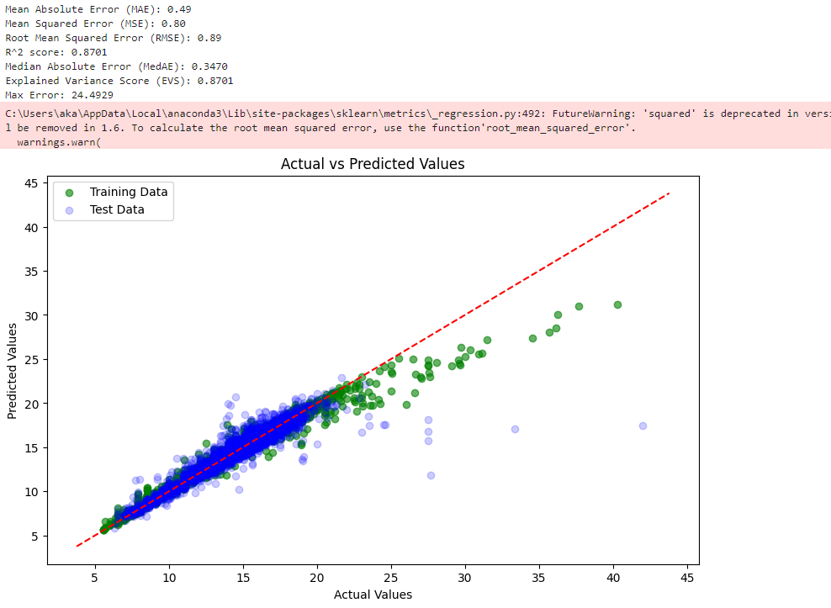
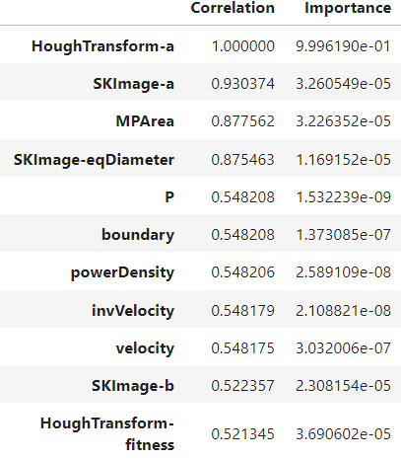
Results
Notes:
In the tables here with correlation and importance, on the left I sorted it and did the feature selection function while considering all the features. The graph in the middle, using the model I created, gets the top 5 variables from the left table and compares them with the HoughTransform-a. This first model is very accurate as we can see from our error metrics at the top, the closer the R^2 value to 1 the more accurate the model is.

Slide 15
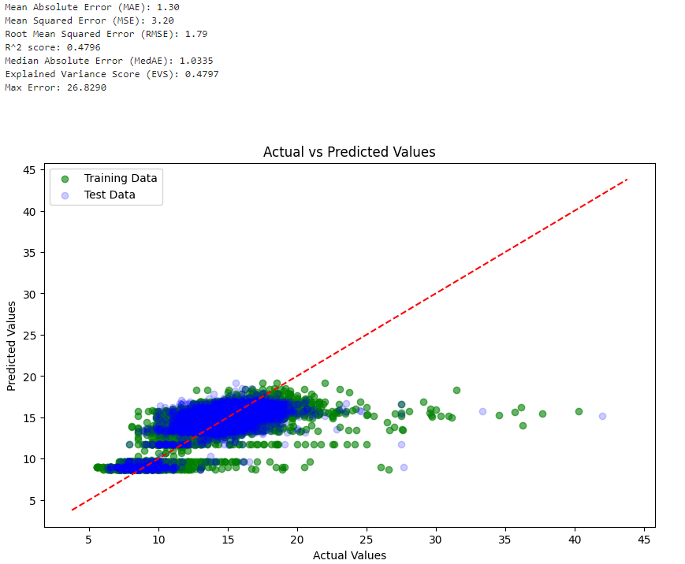
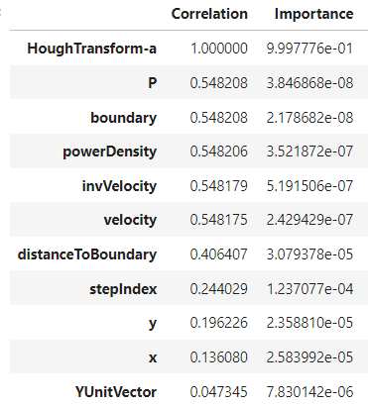
Results
Notes:
On the left, I removed features that had a relationship to HoughTransform-a such as MPArea, SKImage-a, HoughTransform-b because they all have a high correlation by default. This allows us to see what other variables that aren't already correlated have an effect on the variable. I took the top 5 on this aside from Power (P) because it would make the graph 2 flat lines due to power being only 2 distinct values and not a range.

Slide 16
Results

Slide 17
Error Metrics Comparison
Considering All Features
Considering Unrelated Features
Notes:
The closer the R^2 value to 1 the better. As we can see after removing the related variables, there was a large decrease in the value dropping form 0.87 to around 0.48

Slide 18

Conclusion
This summer at NIST I felt that I have learned a tremendous amount. I started off being brand new, to using libraries like pandas, matplotlib and becoming very familiar with them, learning syntax, and applying them to my work. I think that this experience has been very rewarding to say the least and I am very grateful I could be a part of NIST and learn so much along the way.

Slide 19
Thank you
Ayyoub Aggour
Any Questions, Comments, Concerns?

